Slide 1
System & Network Administration
Reliable Products, Server Hardware, Maintenance & Data Integrity
Instructor: Adnan Majeed

Slide 2
Reliable Products
Definition: Consistently perform with minimal downtime
Key Features: Uptime, Scalability, Vendor Support
Examples: Dell PowerEdge, HP ProLiant, Cisco Routers, Juniper Switches
Diagram: Reliability Pyramid (uptime, performance, scalability)

Slide 3
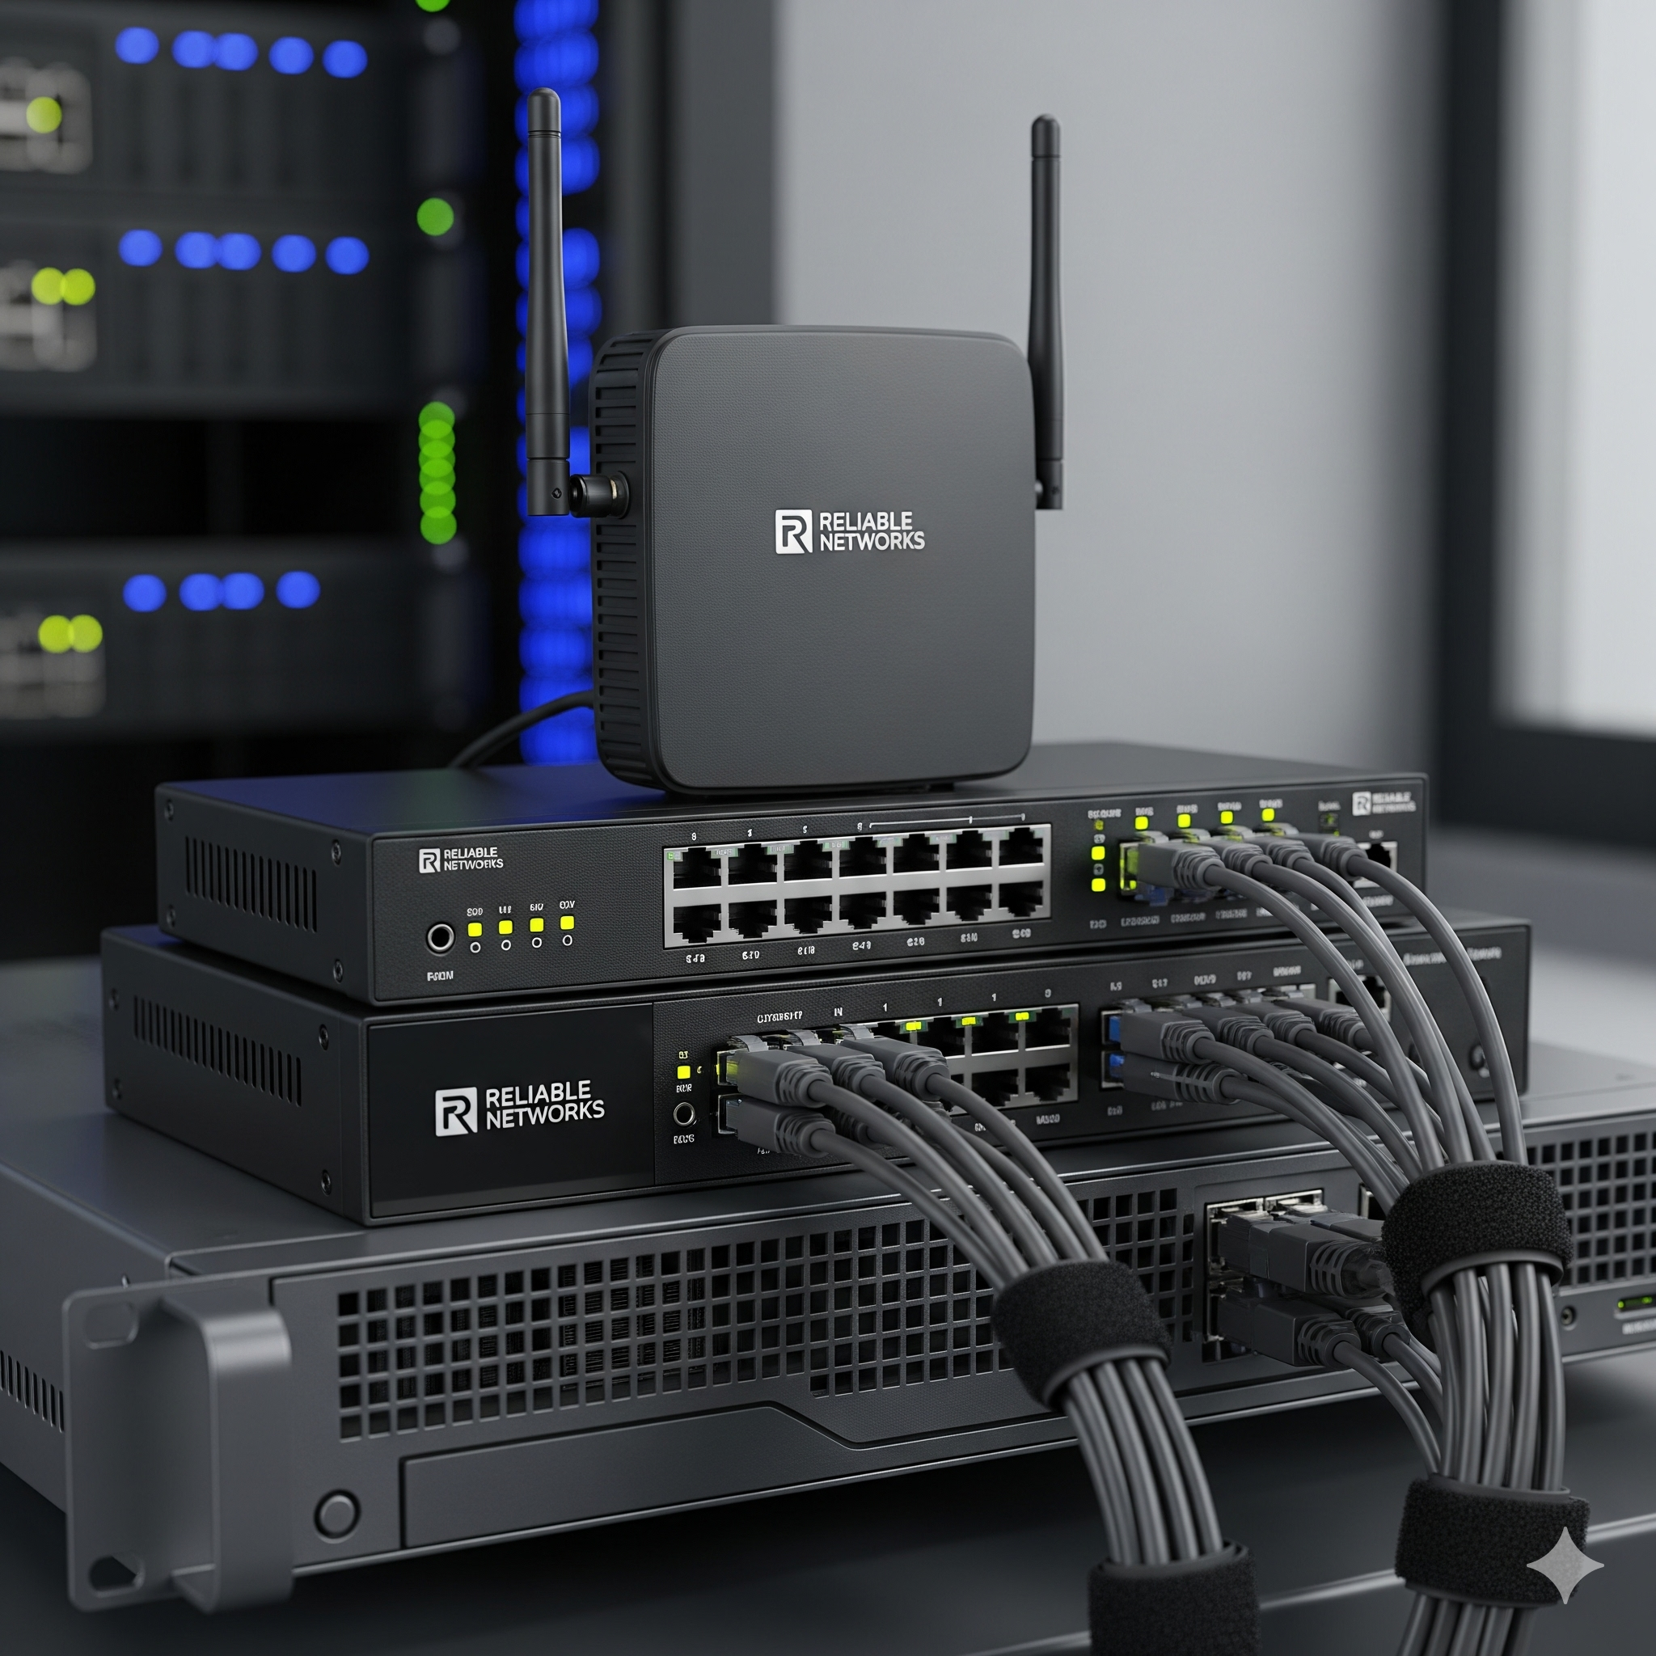

Slide 4
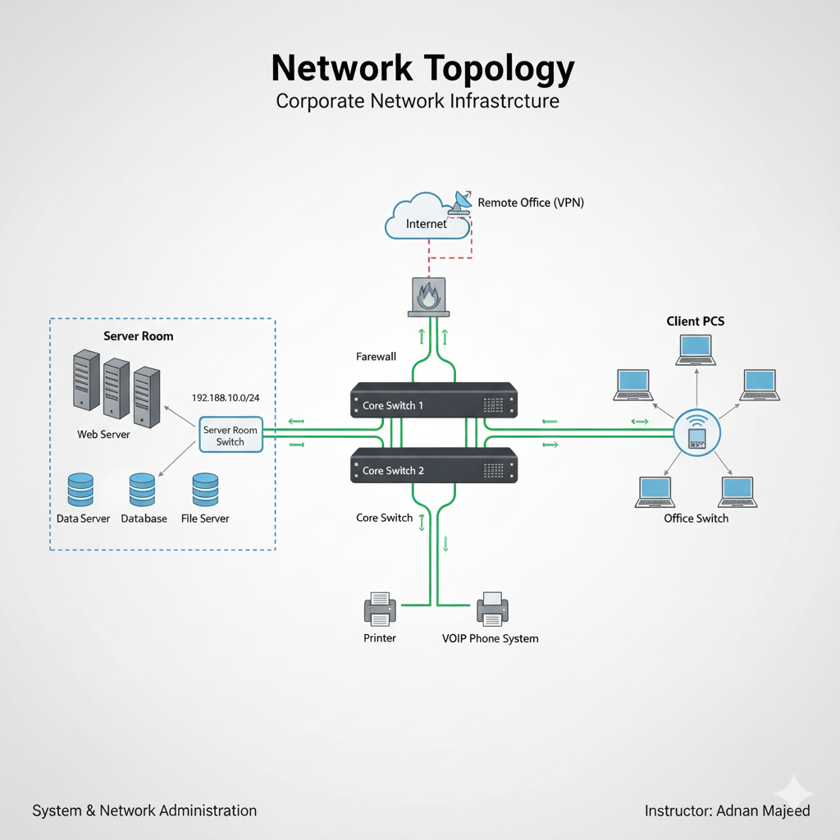

Slide 5
Server Hardware Costing - Factors
Factors influencing cost:
Server Types: Tower (low cost), Rack (datacenters), Blade (high density)
Specifications: CPU, RAM (ECC), Storage (SSD vs HDD, RAID)
Licensing & Software Costs
Operational Costs: Cooling, Power, UPS

Slide 6
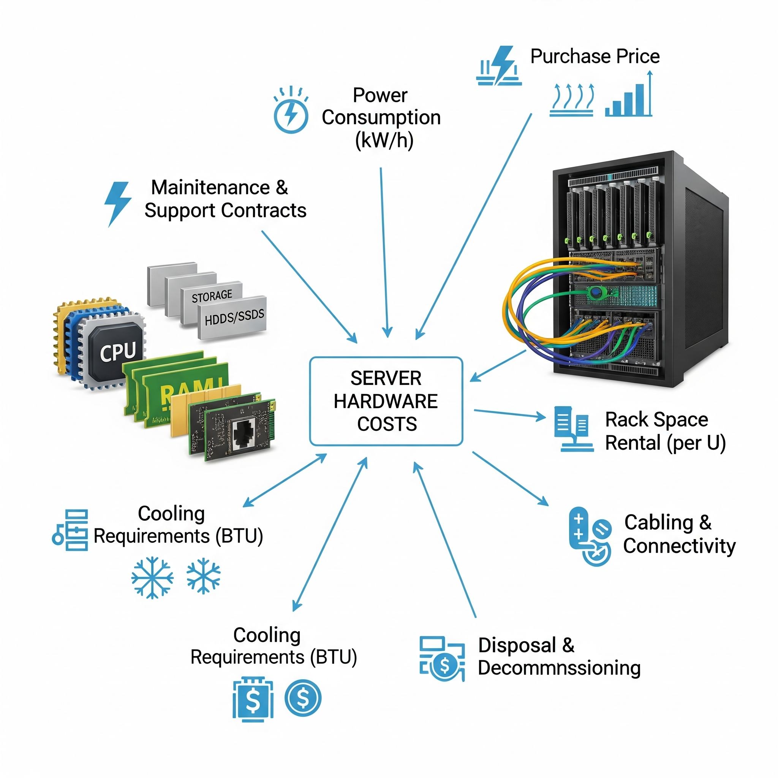

Slide 7
Server Hardware Costing - Example
Example Rack Server Calculation:
Base Price = $3,500
RAM Upgrade (64GB) = $800
SSD RAID Storage = $1,200
License (Windows Server) = $1,000
Power & Cooling (per year) = $600
Total (3 years) = $8,900
TCO: Initial + Operational Costs

Slide 8
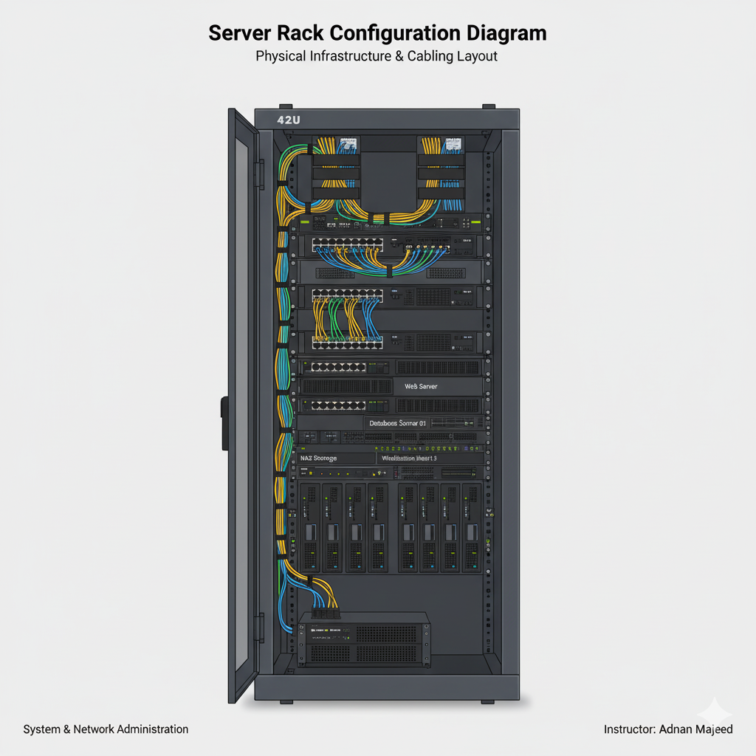

Slide 9
Maintenance Contracts
Standard Warranty vs SLA vs Extended Warranty
Benefits: Reduced downtime, quick response, certified spares
SLA Example: 4-hour response time = Premium, 24-hour = Lower cost

Slide 10
Spare Parts Management
Critical spares: HDDs, RAM, Power Supplies
Maintain inventory system for replacements
Standardization simplifies management
Spare Part Cycle: Purchase → Storage → Replacement → Disposal

Slide 11
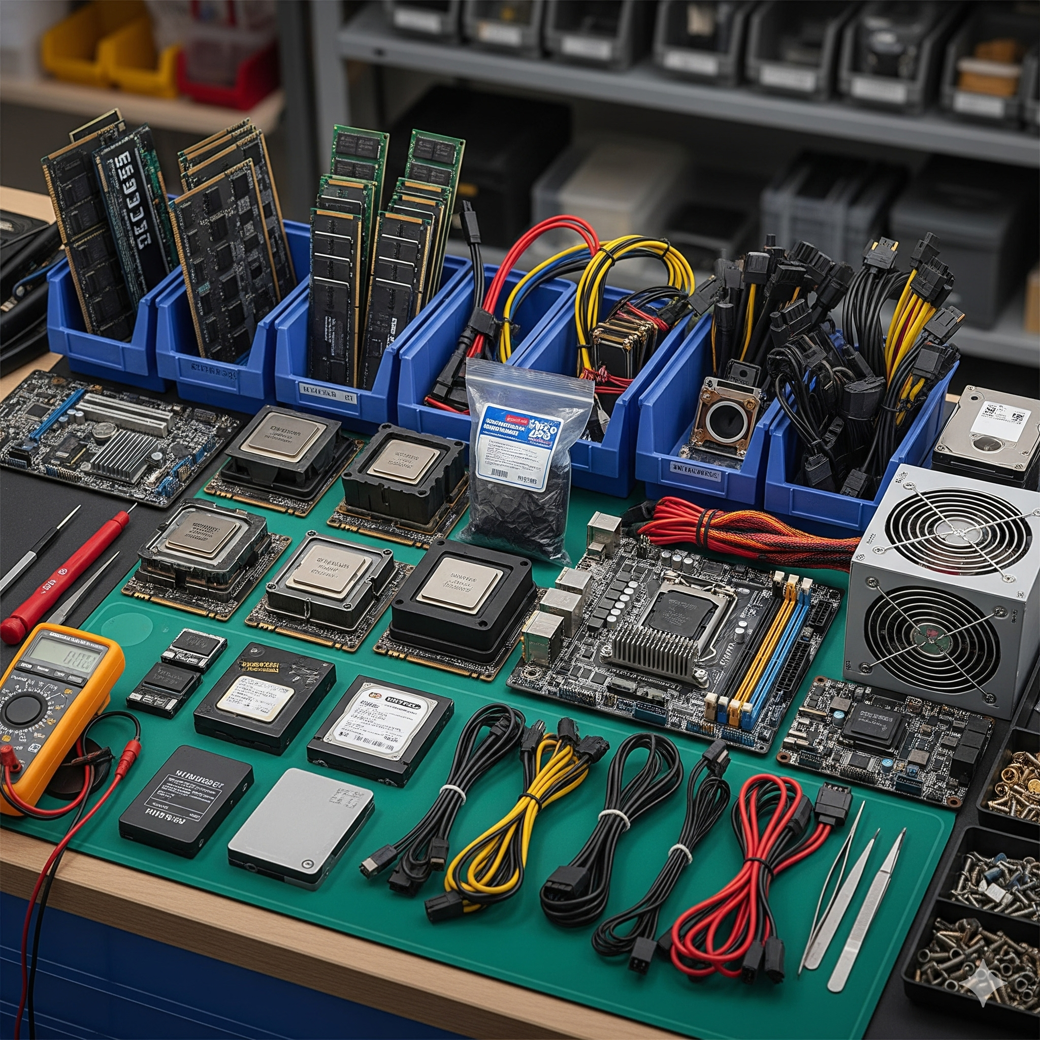
Spare parts

Slide 12
Maintaining Data Integrity
Definition: Accuracy, Consistency, Security
Methods: Backups, RAID (1, 5, 10), Checksums/Hashing
Access Control & Encryption
Disaster Recovery: Failover Servers, Redundancy
Backup Strategy: Daily Incremental, Weekly Full, Monthly Archive

Slide 13
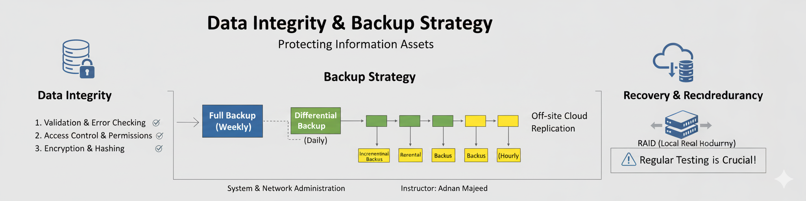

Slide 14
Case Study - Example Analysis
Scenario: Mid-size company with 100 employees
Requirements: 2 Rack Servers (file + application), Backup Server
SLA with vendor (24-hour response)
Cost Breakdown (3 Years):
Rack Servers (x2) = $7,000
Backup Server = $3,500
Licensing = $2,500
SLA (3 Years) = $2,000
Spare Parts = $1,000
Total = $16,000

Slide 15
Summary
Reliable products = Ensure uptime & scalability
Server costing = Consider TCO, not just purchase price
Maintenance contracts & spares reduce downtime
Data integrity protects business-critical data

